Slide 1
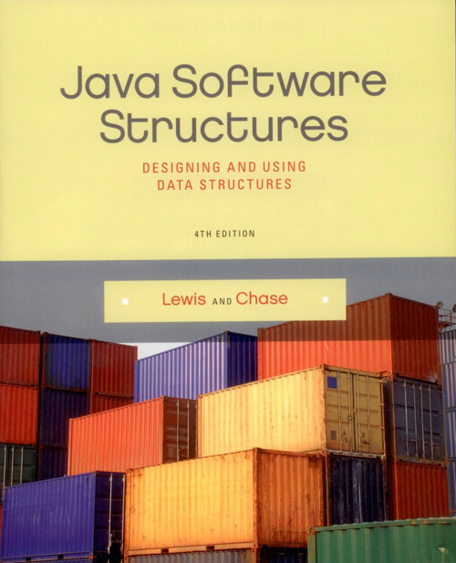
Chapter 7
Iterators

Slide 2
Chapter Scope
The purpose of an iterator
The Iterator and Interable interfaces
The concept of fail-fast collections
Using iterators to solve problems
Iterator implementations

Slide 3
Iterators
Using various methods, the user could write code to access each element in a collection, but it would be slightly different for each collection
An iterator is an object that allows the user to acquire and use each element in a collection
It works with a collection, but is a separate object
An iterator simplifies the classic step of processing elements in a collection

Slide 4
Iterators
There are two key interfaces in the Java API related to iterators:
Iterator – used to define an iterator
Iterable – used to define a collection that provides an iterator
A collection is Iterable, which means it will provide an Iterator when requested

Slide 5
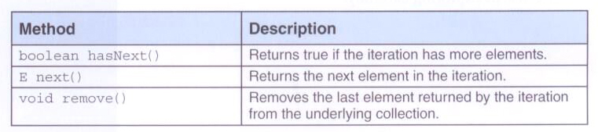

Iterators
The Iterator interface:
The Iterable interface:

Slide 6
Iterators
Suppose myList is an ArrayList of Book objects
Iterator<Book> itr = myList.iterator();
while (itr.hasNext())
System.out.println(itr.next());
The first line obtains the iterator, then the loop uses hasNext and next to access and print each book

Slide 7
Iterators
A for-each loop can be used for the same goal:
for (Book book : myList)
System.out.println(book);
The for-each loop uses an iterator behind the scenes
The for-each loop can be used on any object that is Iterable

Slide 8
Iterators
You may want to use an iterator explicitly if you don't want to process all elements
i.e., searching for a particular element
You may also use an explicit iterator if you want to call the remove method
The for-each loop does not give access to the iterator, so remove cannot be called

Slide 9
Iterators
You shouldn't assume that an iterator will deliver the elements in any particular order unless the documentation explicitly says you can
Also, remember that an iterator is accessing the elements stored in the collection
The structure of the underlying collection should not be changed while an iterator is being used
Most iterators in the Java API are fail-fast, meaning they throw an exception if the collection is modified while the iterator is active

Slide 10
Program of Study Revisited
The ProgramOfStudy class was introduced in the last chapter
It implements the Iterable interface
Its iterator method returns the iterator provided by the list
The POSGrades class uses a for-each loop to print courses with a grade of A or A-

Slide 11
import java.io.FileInputStream;
import java.io.FileNotFoundException;
import java.io.FileOutputStream;
import java.io.IOException;
import java.io.ObjectInputStream;
import java.io.ObjectOutputStream;
import java.io.Serializable;
import java.util.Iterator;
import java.util.LinkedList;
import java.util.List;
/**
* Represents a Program of Study, a list of courses taken and planned, for an
* individual student.
*
* @author Lewis and Chase
* @version 4.0
*/
public class ProgramOfStudy implements Iterable<Course>, Serializable
{
private List<Course> list;
/**
* Constructs an initially empty Program of Study.
*/
public ProgramOfStudy()
{
list = new LinkedList<Course>();
}

Slide 12
/**
* Adds the specified course to the end of the course list.
*
* @param course the course to add
*/
public void addCourse(Course course)
{
if (course != null)
list.add(course);
}
/**
* Finds and returns the course matching the specified prefix and number.
*
* @param prefix the prefix of the target course
* @param number the number of the target course
* @return the course, or null if not found
*/
public Course find(String prefix, int number)
{
for (Course course : list)
if (prefix.equals(course.getPrefix()) &&
number == course.getNumber())
return course;
return null;
}

Slide 13
/**
* Adds the specified course after the target course. Does nothing if
* either course is null or if the target is not found.
*
* @param target the course after which the new course will be added
* @param newCourse the course to add
*/
public void addCourseAfter(Course target, Course newCourse)
{
if (target == null || newCourse == null)
return;
int targetIndex = list.indexOf(target);
if (targetIndex != -1)
list.add(targetIndex + 1, newCourse);
}

Slide 14
/**
* Replaces the specified target course with the new course. Does nothing if
* either course is null or if the target is not found.
*
* @param target the course to be replaced
* @param newCourse the new course to add
*/
public void replace(Course target, Course newCourse)
{
if (target == null || newCourse == null)
return;
int targetIndex = list.indexOf(target);
if (targetIndex != -1)
list.set(targetIndex, newCourse);
}
/**
* Creates and returns a string representation of this Program of Study.
*
* @return a string representation of the Program of Study
*/
public String toString()
{
String result = "";
for (Course course : list)
result += course + "\n";
return result;
}

Slide 15
/**
* Returns an iterator for this Program of Study.
*
* @return an iterator for the Program of Study
*/
public Iterator<Course> iterator()
{
return list.iterator();
}
/**
* Saves a serialized version of this Program of Study to the specified
* file name.
*
* @param fileName the file name under which the POS will be stored
* @throws IOException
*/
public void save(String fileName) throws IOException
{
FileOutputStream fos = new FileOutputStream(fileName);
ObjectOutputStream oos = new ObjectOutputStream(fos);
oos.writeObject(this);
oos.flush();
oos.close();
}

Slide 16
/**
* Loads a serialized Program of Study from the specified file.
*
* @param fileName the file from which the POS is read
* @return the loaded Program of Study
* @throws IOException
* @throws ClassNotFoundException
*/
public static ProgramOfStudy load(String fileName) throws IOException, ClassNotFoundException
{
FileInputStream fis = new FileInputStream(fileName);
ObjectInputStream ois = new ObjectInputStream(fis);
ProgramOfStudy pos = (ProgramOfStudy) ois.readObject();
ois.close();
return pos;
}
}

Slide 17
import java.io.FileInputStream;
import java.io.IOException;
import java.io.ObjectInputStream;
/**
* Demonstrates the use of an Iterable object (and the technique for reading
* a serialzed object from a file).
*
* @author Lewis and Chase
* @version 4.0
*/
public class POSGrades
{
/**
* Reads a serialized Program of Study, then prints all courses in which
* a grade of A or A- was earned.
*/
public static void main(String[] args) throws Exception
{
ProgramOfStudy pos = ProgramOfStudy.load("ProgramOfStudy");
System.out.println(pos);
System.out.println("Classes with Grades of A or A-\n");
for (Course course : pos)
{
if (course.getGrade().equals("A") || course.getGrade().equals("A-"))
System.out.println(course);
}
}
}

Slide 18
Program of Study Revisited
Now we'll use an iterator to remove any course in the program of study that doesn't already have a grade
Since the iterator's remove method will be used, we cannot use a for-each loop

Slide 19
import java.io.FileInputStream;
import java.io.ObjectInputStream;
import java.util.Iterator;
/**
* Demonstrates the use of an explicit iterator.
*
* @author Lewis and Chase
* @version 4.0
*/
public class POSClear
{
/**
* Reads a serialized Program of Study, then removes all courses that
* don't have a grade.
*/
public static void main(String[] args) throws Exception
{
ProgramOfStudy pos = ProgramOfStudy.load("ProgramOfStudy");
System.out.println(pos);
System.out.println("Removing courses with no grades.\n");

Slide 20
Iterator<Course> itr = pos.iterator();
while (itr.hasNext())
{
Course course = itr.next();
if (!course.taken())
itr.remove();
}
System.out.println(pos);
pos.save("ProgramOfStudy");
}
}

Slide 21
Implementing Array-based Iterators
Our ArrayList class contains a private inner class that defines an iterator for the list
An iterator is an appropriate use for an inner class because of its intimate relationship with the outer class (the collection)
It maintains a modification count that is initialized to the current number of elements in the collection
If those counts get out of a sync, the iterator throws a ConcurrentModificationException

Slide 22
/**
* ArrayListIterator iterator over the elements of an ArrayList.
*/
private class ArrayListIterator implements Iterator<T>
{
int iteratorModCount;
int current;
/**
* Sets up this iterator using the specified modCount.
*
* @param modCount the current modification count for the ArrayList
*/
public ArrayListIterator()
{
iteratorModCount = modCount;
current = 0;
}

Slide 23
/**
* Returns true if this iterator has at least one more element
* to deliver in the iteration.
*
* @return true if this iterator has at least one more element to deliver
* in the iteration
* @throws ConcurrentModificationException if the collection has changed
* while the iterator is in use
*/
public boolean hasNext() throws ConcurrentModificationException
{
if (iteratorModCount != modCount)
throw new ConcurrentModificationException();
return (current < rear);
}

Slide 24
/**
* Returns the next element in the iteration. If there are no
* more elements in this iteration, a NoSuchElementException is
* thrown.
*
* @return the next element in the iteration
* @throws NoSuchElementException if an element not found exception occurs
* @throws ConcurrentModificationException if the collection has changed
*/
public T next() throws ConcurrentModificationException
{
if (!hasNext())
throw new NoSuchElementException();
current++;
return list[current - 1];
}

Slide 25
/**
* The remove operation is not supported in this collection.
*
* @throws UnsupportedOperationException if the remove method is called
*/
public void remove() throws UnsupportedOperationException
{
throw new UnsupportedOperationException();
}
}
}

Slide 26
Implementing Linked-Based Iterators
Similarly, an iterator can use links
Like the previous example, the LinkedListItertor class is implemented as a private inner class

Slide 27
/**
* LinkedIterator represents an iterator for a linked list of linear nodes.
*/
private class LinkedListIterator implements Iterator<T>
{
private int iteratorModCount; // the number of elements in the collection
private LinearNode<T> current; // the current position
/**
* Sets up this iterator using the specified items.
*
* @param collection the collection the iterator will move over
* @param size the integer size of the collection
*/
public LinkedListIterator()
{
current = head;
iteratorModCount = modCount;
}

Slide 28
/**
* Returns true if this iterator has at least one more element
* to deliver in the iteration.
*
* @return true if this iterator has at least one more element to deliver
* in the iteration
* @throws ConcurrentModificationException if the collection has changed
* while the iterator is in use
*/
public boolean hasNext() throws ConcurrentModificationException
{
if (iteratorModCount != modCount)
throw new ConcurrentModificationException();
return (current != null);
}

Slide 29
/**
* Returns the next element in the iteration. If there are no
* more elements in this iteration, a NoSuchElementException is
* thrown.
*
* @return the next element in the iteration
* @throws NoSuchElementException if the iterator is empty
*/
public T next() throws ConcurrentModificationException
{
if (!hasNext())
throw new NoSuchElementException();
T result = current.getElement();
current = current.getNext();
return result;
}

Slide 30
/**
* The remove operation is not supported.
*
* @throws UnsupportedOperationException if the remove operation is called
*/
public void remove() throws UnsupportedOperationException
{
throw new UnsupportedOperationException();
}
}
}

